Slide 1

Week 11
LO.4 - Developing a range of core employability skills reflecting compassion, values and behaviours.

Slide 2

Aim;
Critically analyse progress in developing a range of core employability skills reflecting compassion, values and behaviours.
Learning outcomes;
At the end of this lesson students will be able to:
1. Explaining the 6Cs in care as core employability skill in healthcare sector
2. Analysing core employability skills that reflects compassion, values and professional behaviours of health and social care professionals

Slide 3


Slide 4


Slide 5
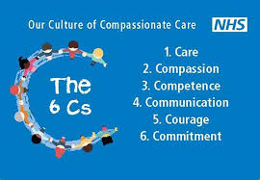
Now…. lets look at The 6 Cs in Care as a healthcare care professional standard

Slide 6

LO 2 Activity (10 minutes)
Individually/ pair group,
From the video link
Identify and explain the 6Cs in care
Feedback to the class
https://www.youtube.com/watch?feature=player_embedded&v=VztWjL1TlGk

Slide 7
Video link to the 6 C’s in health and social care
https://www.youtube.com/watch?feature=player_embedded&v=VztWjL1TlGk
(https://www.youtube.com/watch?feature=player_embedded&v=VztWjL1TlGk, 2019)
Website link for information to the 6 C’s
https://www.skillsforcare.org.uk/Documents/Standards-legislation/6Cs/6Cs-in-social-care-guide.pdf
(Skillsforcare.org.uk, 2019)

Slide 8
The 6 Cs’ In Care
Six values are now recognised as applying to health and social care workers.
These are known as ‘The 6 Cs’:
Care: having someone’s best interests at heart and doing what you can to maintain or improve their wellbeing
Compassion: being able to feel for someone, to understand them and their situation
Competence: to understand what someone needs and have the knowledge and skills to provide it
Communication: to listen carefully but also be able to speak and act in a way that the person can understand
Courage: not to have fear to try out new things or to say if you are concerned about anything
Commitment: dedication to providing care and support but also understanding the responsibility you have as a worker.

Slide 9
Care refers to adult care workers providing a high standard of care by being consistent about meeting individuals’ needs and passionate about individuals’ well-being.
Providing a high standard of care means that individuals will feel valued because they will be treated fairly and with respect.
Showing your caring nature will also instil confidence and trust in all your working relationships with individuals and others involved in their lives.
Care

Slide 10
Caring
All adult care workers must have a caring nature and be able to demonstrate this when they work with individuals and others such as individuals’ families and friends.
For example, when caring for an individual who is feeling unwell you must show genuine interest in the individual’s wellbeing, for example by ensuring that the individual is comfortable and reassuring the individual’s family that you are doing your best to look after their relative

Slide 11


Compassion
Compassion refers to providing care and support to individuals by taking the time to try and understand their perspective in terms of what good care and support means to them and the reasons why.
Being compassionate requires you to be kind towards individuals and others, considerate of their feelings and respectful of their views that may be different to your own.
Underlying compassionate care is being able to maintain the dignity of individuals,

Slide 12
All adult care workers must have compassion and be able to demonstrate this to the individuals and others they work with such as their colleagues.
For example, when meeting with an individual with dementia who is refusing to be cared for by one of your colleagues, you must show your understanding of both the individual and your colleague, by for example putting yourself in the individual’s shoes to try and understand how they are feeling while also considering the situation from your colleague’s perspective.
Compassionate

Slide 13
https://youtu.be/HVF0273iHus
The Health Foundation
Compassion 'has to be our number one priority' says Hiro Tanaka, a consultant orthopaedic surgeon at Aneurin Bevan University Health Board.
We spoke to him about the value he places on compassion in delivering care, and also spoke to a range of staff members from the hospital about what compassion means to them and how they incorporate it in their day to day work.
We also hear from some patients about the difference that compassionate care has made to them during their time in hospital.

Slide 14
Courage refers to providing care and support that always promotes individuals’ safety. Being courageous as an adult care worker requires you to always promote individuals’ well-being and maintain their best interest as the focus of the care you provide.
This means that you must always be ready to do the right thing for individuals including speaking up for individuals if they are at risk of harming themselves and/or others, of being hurt by others or when there is a risk of a criminal offence being carried out.
Courage

Slide 15
All adult care workers must be courageous and be able to demonstrate this when providing care and support to individuals.
For example, if an individual is at risk of harming themselves or others then you can show your courage by following your employer’s agreed ways of working for reporting and recording this immediately so that you can promote individuals’ and others’ safety.
You can also show your courage by positively challenging others when you have concerns over any unsafe practices.
Courage-cont…

Slide 16
Competence
Competence refers to applying knowledge and skills to provide high-quality care and support. Being competent requires you to be aware of what you do, how you do it and how it impacts on the individuals you care for and support.
It also means that you have a genuine interest in being the best you can so that individuals can have the very best quality of care that is possible. You can do this by being open to learning about new ways of working and by sharing knowledge and good practice

Slide 17

Commitment
Commitment refers to placing individuals in the centre of their care and support and working in ways that are person-centred so that you can ensure individuals have a positive experience.
Being committed requires you to put yourself in the individual’s ‘shoes’ so that you can fully understand what good care and support means to them.
It also requires you to involve and consult the individual in their care and support and then work with them so that you can continue to ensure that the care and support you provide meets their needs and preferences.
Commitment

Slide 18
Communication
Communication refers to good communication that is effective in relation to building trusting working relationships with individuals and others.
It also requires you to be mindful of the messages you are giving out to others through your day-to-day communication.
Communicating effectively is essential for providing a high standard of care and support, because without good communication misunderstandings may arise that may lead to individuals and others not trusting you and making it very difficult to all work together positively
Being an effective communicator requires you to know about the preferred ways of communicating with individuals and others you work with.

Slide 19

Why are the 6 C's important?
The 6Cs provide a set of values for all health and social care staff and help to ensure that everyone is working towards the same common goal.
Following the 6Cs provides patients with high quality care and should be the cornerstone of all health and social care work.

Slide 20

ROLE OF INDIVIDUALS – the 6C’s
The 6C’s define the behaviours expected of individuals that support professional practice.
I CARE about…
Patients – Each encounter is an opportunity to convey compassionate, empathetic care through
listening, learning from, coaching, and teaching patients and families.
Self-Awareness, self-reflection, and self care – I recognize the impact of my insight and well
being on my practice
• Relationships on my team – Each encounter is an opportunity to support another’s wellbeing
and practice. I foster respectful, constructive interactions, and celebrate other’s successes.
I am COMPETENT because I…
• Reflect on my practice and develop a continuing competence plan to improve patient outcomes.
Invest time, effort, and resources to improve my knowledge, skills, clinical reasoning, and
judgment.
Take responsibility for my professional development, incorporating evaluation, new knowledge,
and evidence in my practice.
• Am confident to lead in my practice and share knowledge with others, including students.

Slide 21
I COMMIT to practice in alignment with…
The role, functions, and expectations of my position.
My organisation vision, mission, values, and policies.
My Professional Standards of Practice, Code of Ethics and my professional role.
Regulation and legislation.
I COLLABORATE…
With patients and families in all of their health care decisions, every time, respecting their
decisions.
To deliver patient and family centred care, engaging patients and their loved ones as full
partners in their care, and as part of the health care team.
With other health care providers, leaders, communities, and educational groups.
To understand and actualize my organisation’s Collaborative Practice Principles in order to support patient
and family centred care.
To support smooth patient transitions between providers, programs, and settings.
By identifying, pursuing and promoting opportunities for patient safety, quality, and continuous
improvement.

Slide 22
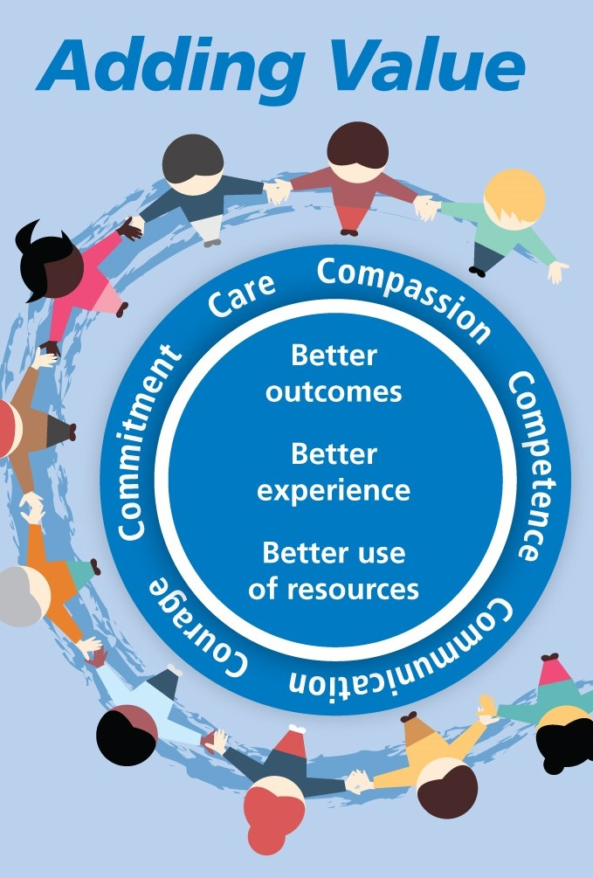
I CREATE…
Successes with my patients for my patients – I deliver the best possible outcomes and positive
Interactions, including advocating on their behalf when necessary.
A safe, welcoming, and engaging environment for patients, families, co-workers', and students.
Opportunities to contribute to my profession by participating in professional and workplace
Opportunities, including research and evaluation.

Slide 23


10 minutes break

Slide 24
Now….let look more at compassion, value and professional behaviour

Slide 25
‘Organisational compassion exists when members of a system collectively notice, feel, and respond to pain experienced by members of that system.’ Kanov et al. (2004, p. 810)
The case for compassion in the workplace – and throughout society as a whole – has grown significantly in recent times. The coronavirus outbreak has demanded we display greater kindness and empathy towards colleagues, whether on the frontline or working from home. A compassionate approach is vital to remain connected, mentally healthy, and productive while we battle through the challenges we face at work and beyond.
Compassion is also critical in our response to tackling racism in the workplace. Creating inclusive organisational cultures involves connecting with people on a deeper level, listening to and understanding what it means to experience inequality, and taking action in response.
The role of compassion in the workplace

Slide 26
The role of compassion
Compassion is the foundation for a humanistic approach in business, correctly placing people front and centre.
It involves responding to another’s suffering through positive action and requires interpersonal skills and an individualised approach.
Compassion and compassionate leadership have many benefits for individuals and organisations.
Yet, the conversation surrounding workplace compassion is still in its infancy, at a time when it has never been more vital.

Slide 27
https://youtu.be/HVF0273iHus
Activity:
Click anywhere on the digital noticeboard below to share your thoughts regarding the following:
Can you think of three things you feel the staff did well?
What do you think impacted on the patients the most?

Slide 28
Compassion in the context of the workplace
Compassion is defined as ‘an empathetic emotional response to another person’s pain or suffering that moves people to act in a way that will either ease the person’s condition or make it more bearable’ Lilius et al. (2003, p.4).
Compassion plays a role at different levels within an organisation. At an organisational level, it requires members of the system to embed compassionate processes to alleviate the suffering and stresses experienced by individuals within that system.
This is not restricted to employees alone and includes others such as customers and clients. Leaders and managers must manage and lead with compassion. At an individual level, each member of the organisation must take responsibility to act with empathy and demonstrate support for their colleagues.

Slide 29
Academic literature suggests that compassion within the context of the workplace is relational and process orientated. A review of compassion at work noted six key organisational aspects that are relevant to compassion (Dutton, Workman & Hardin (2014)):
Shared values - a set of values that an organisation and its people perceive to be important.
Shared beliefs - actual organisational beliefs held by employees.
Norms - the normative organisational behaviours that shape how employees act and respond to one another.
Organisational practices - practices which support and shape compassion in the workplace.
Structure and quality of relationships - the quality of human connections between employees, either dyadic or across the organisational network.
Leaders’ behaviours - the importance of leaders’ actions, specifically the signalling and modelling of appropriate behaviours and response to employees’ suffering.

Slide 30
Negative interactions and work environments often result in toxic and bullying workplace cultures. These have adverse outcomes for the organisation and the individual.
Positive interpersonal behaviours that take a compassionate approach can minimise negative consequences associated with damaging work environments.

Slide 31
Compassion is not religious business, it is human business, it is not luxury, it is essential for our own peace and mental stability, it is essential for human survival. Dalai Lama XIV
Our task must be to free ourselves... by widening our circle of compassion to embrace all living creatures and the whole of nature and its beauty. Albert Einstein

Slide 32
?
Before we can identify how we can embed compassion in organisations, it is important to understand why we don’t
already do this, especially if this is such a fundamentally human trait and there is so much evidence to demonstrate that
it improves wellbeing and productivity.
Some research has found that some people have a fear of demonstrating compassion towards themselves and
others and a fear of receiving compassion, and this can have a negative impact on leadership skills, and particularly
interpersonal skills. Given that leaders lead by example and model expected behaviours (consciously or not), this
can have a serious negative impact on behaviour throughout an organisation, and is also linked to stress, anxiety and
depression in the individual (Martin and Heineberg, 2017
WHY DO WE LACK EMPATHY AND COMPASSION AT WORK

Slide 33
WRAP-UP
Question and Answer Session

Slide 35

Presenting your assignment
Title page-Your student number, the module and submission date
Content page
Introduction
Font –Ariel, Times New Roman
Font size -12
Line spacing – 1.5
Paragraphing-Not too short or too long
Page number
In text referencing using Harvard referencing style
Reference list using Harvard referencing style
Reference list should be in alphabetical order
Proof read for grammar errors
Submit as a single document i.e. a word document or Pdf
Conclusion

Slide 36
Reference
https://subjectguides.york.ac.uk/skills/reflective-writing

